Slide 1
DATA STRUCTURE PROJECT
Roll no: 2015BIT026
Roll no: 2015BCS026

Slide 2
Problem statement :
Write a program to find weight of minimum spanning tree in a graph using Prim’s Algorithm.
Output format :
Source vertex destination vertex weight
------
------
-----
Total weight of minimum spanning tree :

Slide 3
Algorithm :
1.Initialize a tree with a single vertex, chosen arbitrarily from the graph.
2.Grow the tree by one edge: of the edges that connect the tree to vertices not yet in the tree, find the minimum-weight edge, and transfer it to the tree.
3.Repeat step 2 (until all vertices are in the tree).
It may be implemented following the pseudocode below.
1.Associate with each vertex v of the graph a number C[v] (the cheapest cost of a connection to v) and an edge E[v] (the edge providing that cheapest connection). To initialize these values, set all values of C[v] to +∞ (or to any number larger than the maximum edge weight) and set each E[v] to a special flag value indicating that there is no edge connecting v to earlier vertices.
2.Initialize cost to zero and a set of vertices that have not yet been included in F (initially, all vertices).
3.Repeat the following steps until all vertices are covered
Find and remove a vertex v from grapghhaving the minimum possible value of C[v] and, if E[v] is not the special flag value, also add E[v] to cost
Loop over the edges vw connecting v to other vertices w. For each such edge, if w still belongs to grapg and vw has smaller weight than C[w], perform the following steps:
Set C[w] to the cost of edge vw
Set E[w] to point to edge vw.
Return cost

Slide 4
Algorithm prim(matrix,nov,stvertex)
pre:matrix is array ,nov is the total no of vertices,stvertex is the starting vertex
post:cost of minimum spanning tree is returned//
set i to 0
loop(i less than nov)
set visit[i] to false
increament i
end loop
set visit[stvertex] to true
set nvcount to 1
loop(nvcount less than no)
1.set min to some max value
2.set i to 0 and j to 0
3.loop(i less than nov)
1.if(visit[i] is true)
2.loop(j less than nov)
3.if(visit[j] is false)
1.if(matrix entry not zero)
if(min >matrix entry)
set min to matrix entry
set x to i and set y to j
set cost to cost+min
set visit[y] to true
increament nvcount
return cost

Slide 5
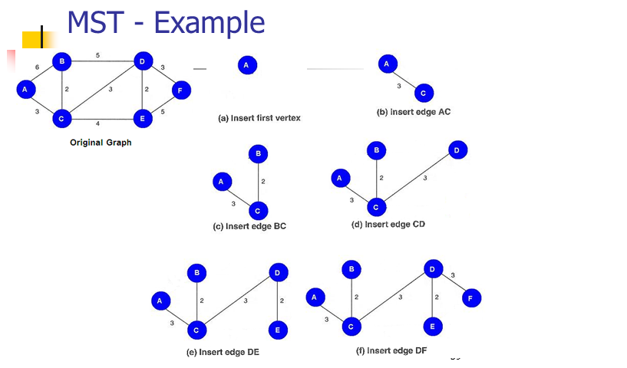
Process :

Slide 6
Applications :
Building a connected network. There are scenarios where we have a limited set of possible routes, and we want to select a subset that will make our network (e.g., electrical grid, computer network) fully connected at the lowest cost.
Clustering. If you want to cluster a bunch of points into kk clusters, then one approach is to compute a minimum spanning tree and then drop the k−1k−1 most expensive edges of the MST. This separates the MST into a forest with kk connected components; each component is a cluster.
Cluster analysis: clustering points in the plane, single-linkage clustering, graph-theoretic clustering, and clustering gene expression data.
Constructing trees for broadcasting in computer networks. On Ethernet networks this is accomplished by means of the Spanning tree protocol.
comparing homogeneity of two-dimensional materials.
Circuit design: implementing efficient multiple constant multiplications, as used in finite impulse response filters.
In salesman problem

Slide 7
Complexity :
the complexity of Prim’s algorithm for a graph having n vertices = O(n^2)

Slide 8
Disadvantages of prim’s algorithm :
Disadvantages of Prim’s algorithm:
1.List of edges has to be searched from beginning as new edge gets added.
2.If there are more than one edges having same weight then all possible spanning trees are required to be found for final minimal tree.

